Slide 1
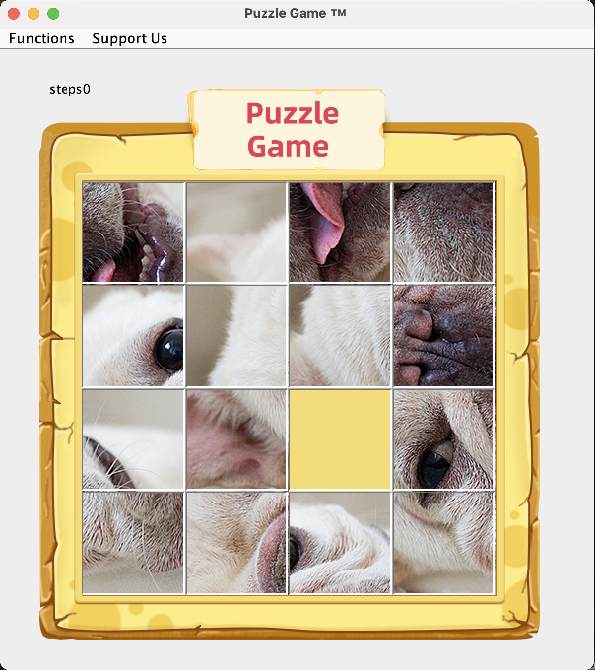
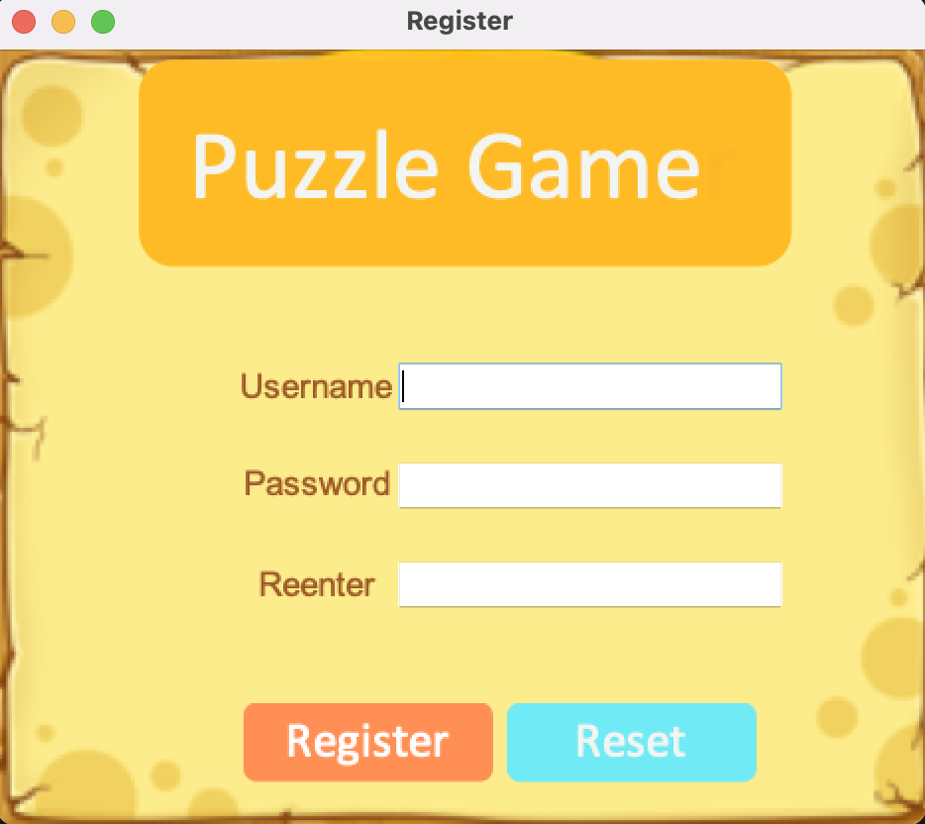
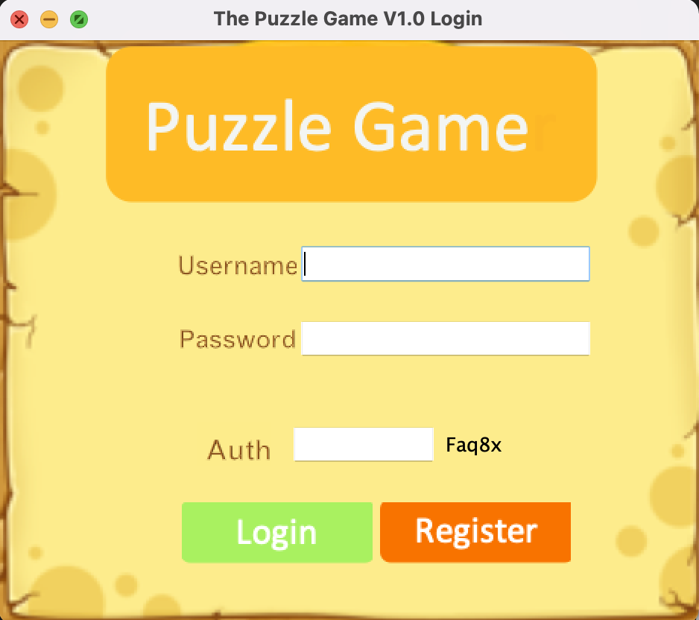
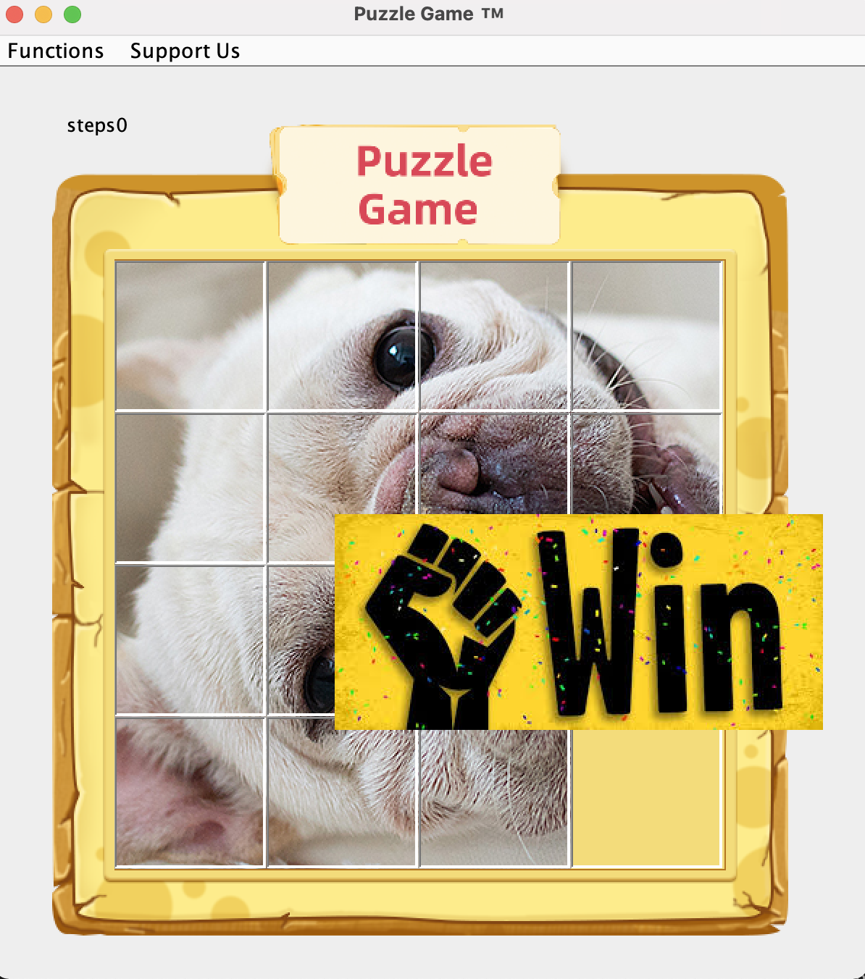
Register
Start game
Login
Change the user
Replay
Win
Reset or Something went wrong
Input the wrong username or password

Slide 2
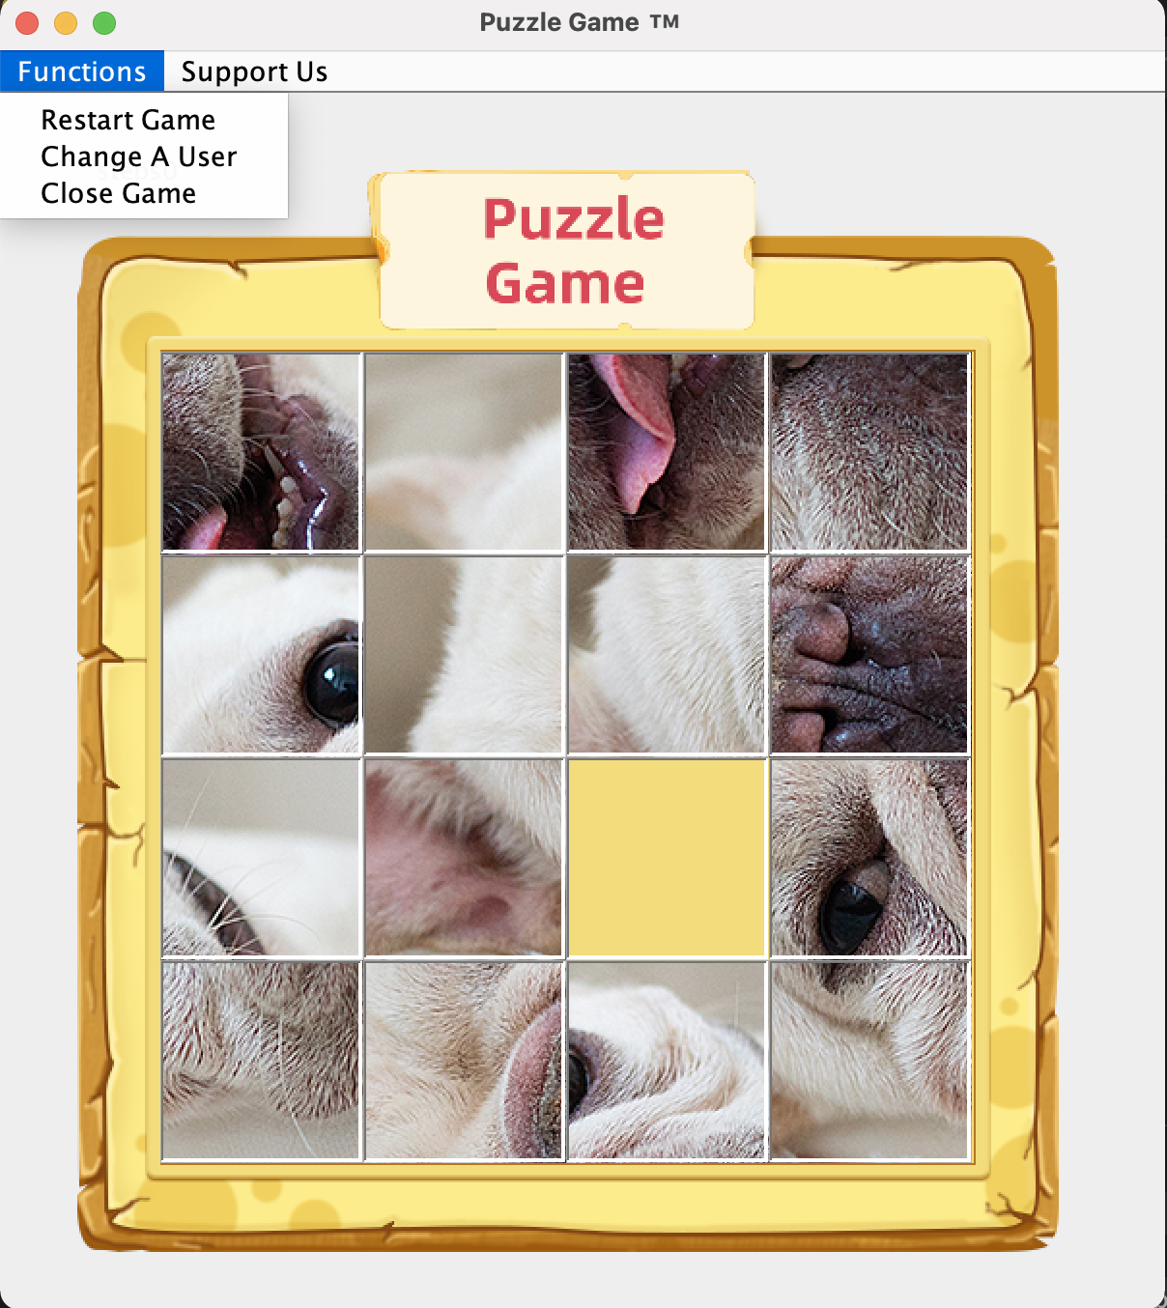

Slide 3
1
2
8
3
5
4
7
6
Exit

